Slide 1

A LSTM network-based model with attention techniques for predicting linear T-cell epitopes of the hepatitis C virus with word embedding techniques
4th March, 2025
Department of Information and Communication Technology
Mawlana Bhashani Scince and Technology University
Tangail-1902, Bangladesh

Slide 2
Supervised By
Submitted By
Dr. Muhammad Shahin Uddin
Professor
Department of ICT, MBSTU
Md. Faruk Hosen
ID: IT21618
Session: 2020-21 (M.Sc)
Department of ICT, MBSTU
3/5/2025
Md. Faruk Hosen, IT-21618
2

Slide 3
Publication
Q1
Journal: Results in Engineering
Cite Score: 5.8
6.0
Impact factor
24 February 2025
Md. Faruk Hosen, IT-21618
3

Slide 4
Outlines
Introduction
Problem Statement
Motivation
Objectives
Literature Review
Proposed Methodology
Result Analysis
Conclusion & Future Work
Achievement
References
Research Question
3/5/2025
Md. Faruk Hosen, IT-21618
4

Slide 5

Introduction
Hepatitis C Virus (HCV) is an RNA virus that targets the liver and is connected with the progressive decline of liver function [1].
It remains a significant global health challenge, affecting approximately 170 million individuals with chronic infections worldwide [2].
Since its discovery around three decades ago, HCV has exhibited substantial genetic variability, complicating vaccine development.
Recent research suggests that the body’s cellular immune response, particularly T cell epitopes of HCV, plays a vital role in fighting the virus.
So, it is important to accurately and efficiently identify T cell epitopes of HCV to develop an effective vaccine.
3/5/2025
Md. Faruk Hosen, IT-21618
5

Slide 6
Problem Statement
1
Traditionally, researchers identify HCV through wet-lab experimental techniques, but these technique require specialized equipment and skilled personnel, which is time consuming and costly.
2
Due to the high variability of the HCV genome, the identification of HCV from primary sequences using conventional ML methods can be challenging. These methods are not showing much reliability or accuracy.
3
Several ML models have been proposed [3]-[4]. But most of the models did not consider NLP based feature extractor. Also, they did not consider any parameter tuning of the proposed models.
3/5/2025
Md. Faruk Hosen, IT-21618
6

Slide 7
Motivation
The main motivation is to ensure effective treatment for people affected by the C virus worldwide, so that they can recover properly from the disease.
We intend to increase the accuracy and efficiency of detecting HCV by incorporating deep learning techniques, specifically LSTM networks with attention mechanisms and word embedding techniques.
3/5/2025
Md. Faruk Hosen, IT-21618
7

Slide 8
Research Question
1
How can HCV be predicted from sequence data using computational methods instead of traditional biological approaches, and what are the key advantages of this shift?
2
How can deep learning techniques be utilized to enhance the prediction of HCV epitopes, and what benefits do they offer over traditional machine learning models?
3
Which feature extraction method—Word2Vec, FastText, GloVe, one-hot encoding, or k-mer embeddings—provides the most informative representation for HCV epitope prediction?
3/5/2025
Md. Faruk Hosen, IT-21618
8

Slide 9
Objectives
To develop a novel predictor for T cell epitopes in HCV, which will contribute significantly to methodological development in the domain of HCV vaccine research.
To utilize a variety of advanced feature extraction methods, including Word2Vec, FastText, GloVe, one-hot encoding, and k-mer embeddings, to create rich and diverse representations of HCV protein sequences.
To Employ SHAP (SHapley Additive exPlanations) to identify and retain the most relevant features, enhancing the interpretability of the models.
To assess how well our proposed model performs in comparison to other established machine learning models for HCV prediction.
3/5/2025
Md. Faruk Hosen, IT-21618
9

Slide 10
Literature Review
No. | Year | Work | Techniques | Limitations
[1] | 2023 | Phasit et al. - "TROLLOPE: A Novel Sequence-Based Stacked Approach for the Accelerated Discovery of Linear T-Cell Epitopes of Hepatitis C Virus" | Used 12 traditional feature descriptors (AAC, DPC, PAAC, TPC, APAAC, etc.), Employed 12 ML algorithms to develop a stacked model | No word embedding techniques, No k-mer technique, Accuracy needs optimization (0.745 CV, 0.747 test)
[2] | 2022 | Bukhari et al. - "Machine Learning Techniques for the Prediction of B-Cell and T-Cell Epitopes as Potential Vaccine Targets with a Specific Focus on SARS-CoV-2 Pathogen: A Review" | Focused on BCE & TCE identification for vaccine design, Reviewed ML tools for epitope prediction | Tools mainly predict peptide-binding capacity, Lack of broader functional insights, Predictions require further validation
24 February 2025
Md. Faruk Hosen, IT-21618
10

Slide 11
Literature Review Cont…
SL | Year | Work | Techniques | Limitations
[3] | 2021 | Robert et al. - "T cell immunity to hepatitis C virus: Lessons for a prophylactic vaccine." | Highlighted metabolic, molecular, and transcriptional features of T cell immunity, Focused on T cell exhaustion in chronic HCV infection | Time-consuming and costly, Unable to use chimpanzee models, Limited knowledge on protective immunity
[4] | 2013 | Dhanda et al. - "Prediction of IL4 inducing peptides" | Analyzed amino acid composition and motif patterns, Applied traditional ML techniques (SVM) | Peptide length as a feature did not enhance performance, Binary pattern models performed poorly (MCC = 0.18), No feature selection method used
24 February 2025
Md. Faruk Hosen, IT-21618
11

Slide 12
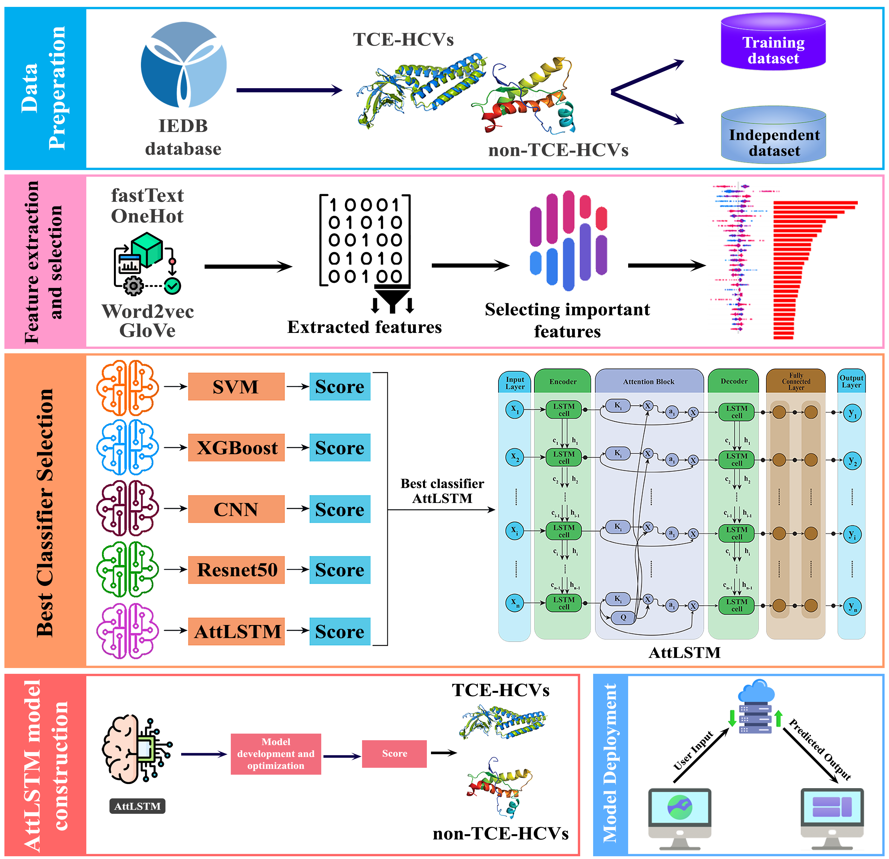
Methodology
Data Pre-processing
Feature Extraction
Best Classifier Selection
Model Deployment
3/5/2025
Md. Faruk Hosen, IT-21618
12

Slide 13
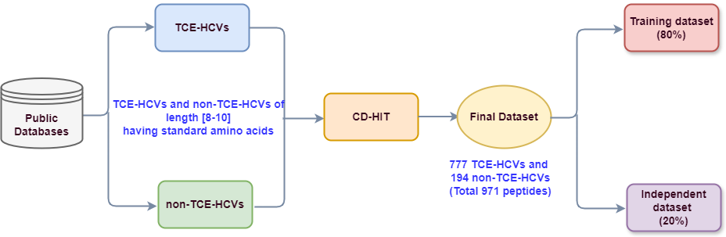
Methodology Cont…
Data Collection:
3/5/2025
Md. Faruk Hosen, IT-21618
13

Slide 14
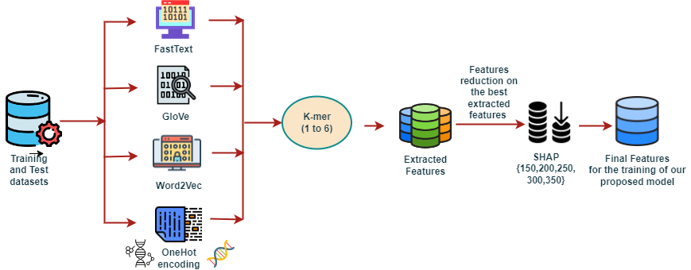
Methodology Cont.…
Feature Extraction and Feature Selection:
3/5/2025
Md. Faruk Hosen, IT-21618
14

Slide 15
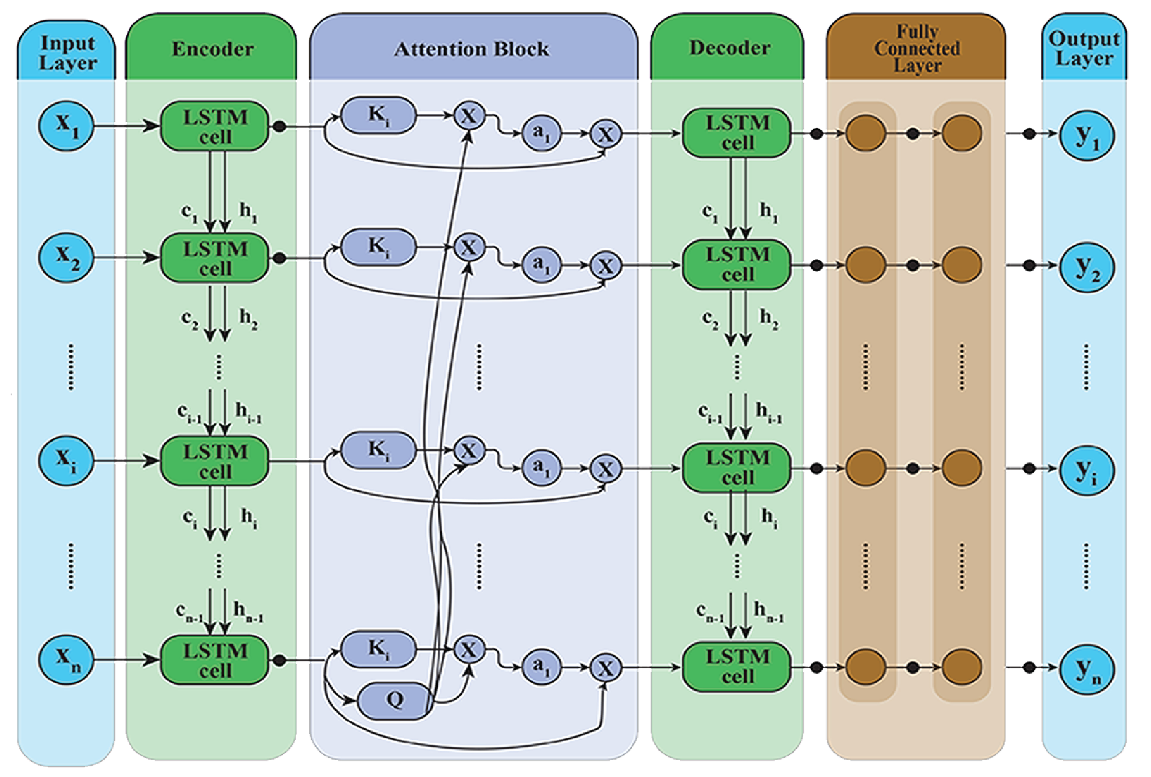
Methodology Cont.…
Internal Architecture of AttLSTM Model
3/5/2025
Md. Faruk Hosen, IT-21618
15

Slide 16
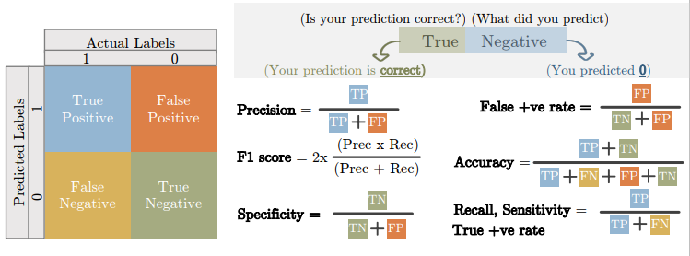

Methodology Cont.…
Model Performance Metrics
3/5/2025
Md. Faruk Hosen, IT-21618
16

Slide 17
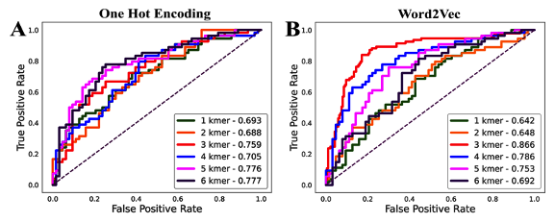
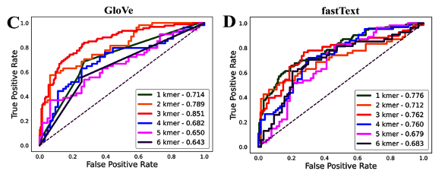
Result Analysis
Performance of each feature for different k-mer lengths
3/5/2025
Md. Faruk Hosen, IT-21618
17

Slide 18
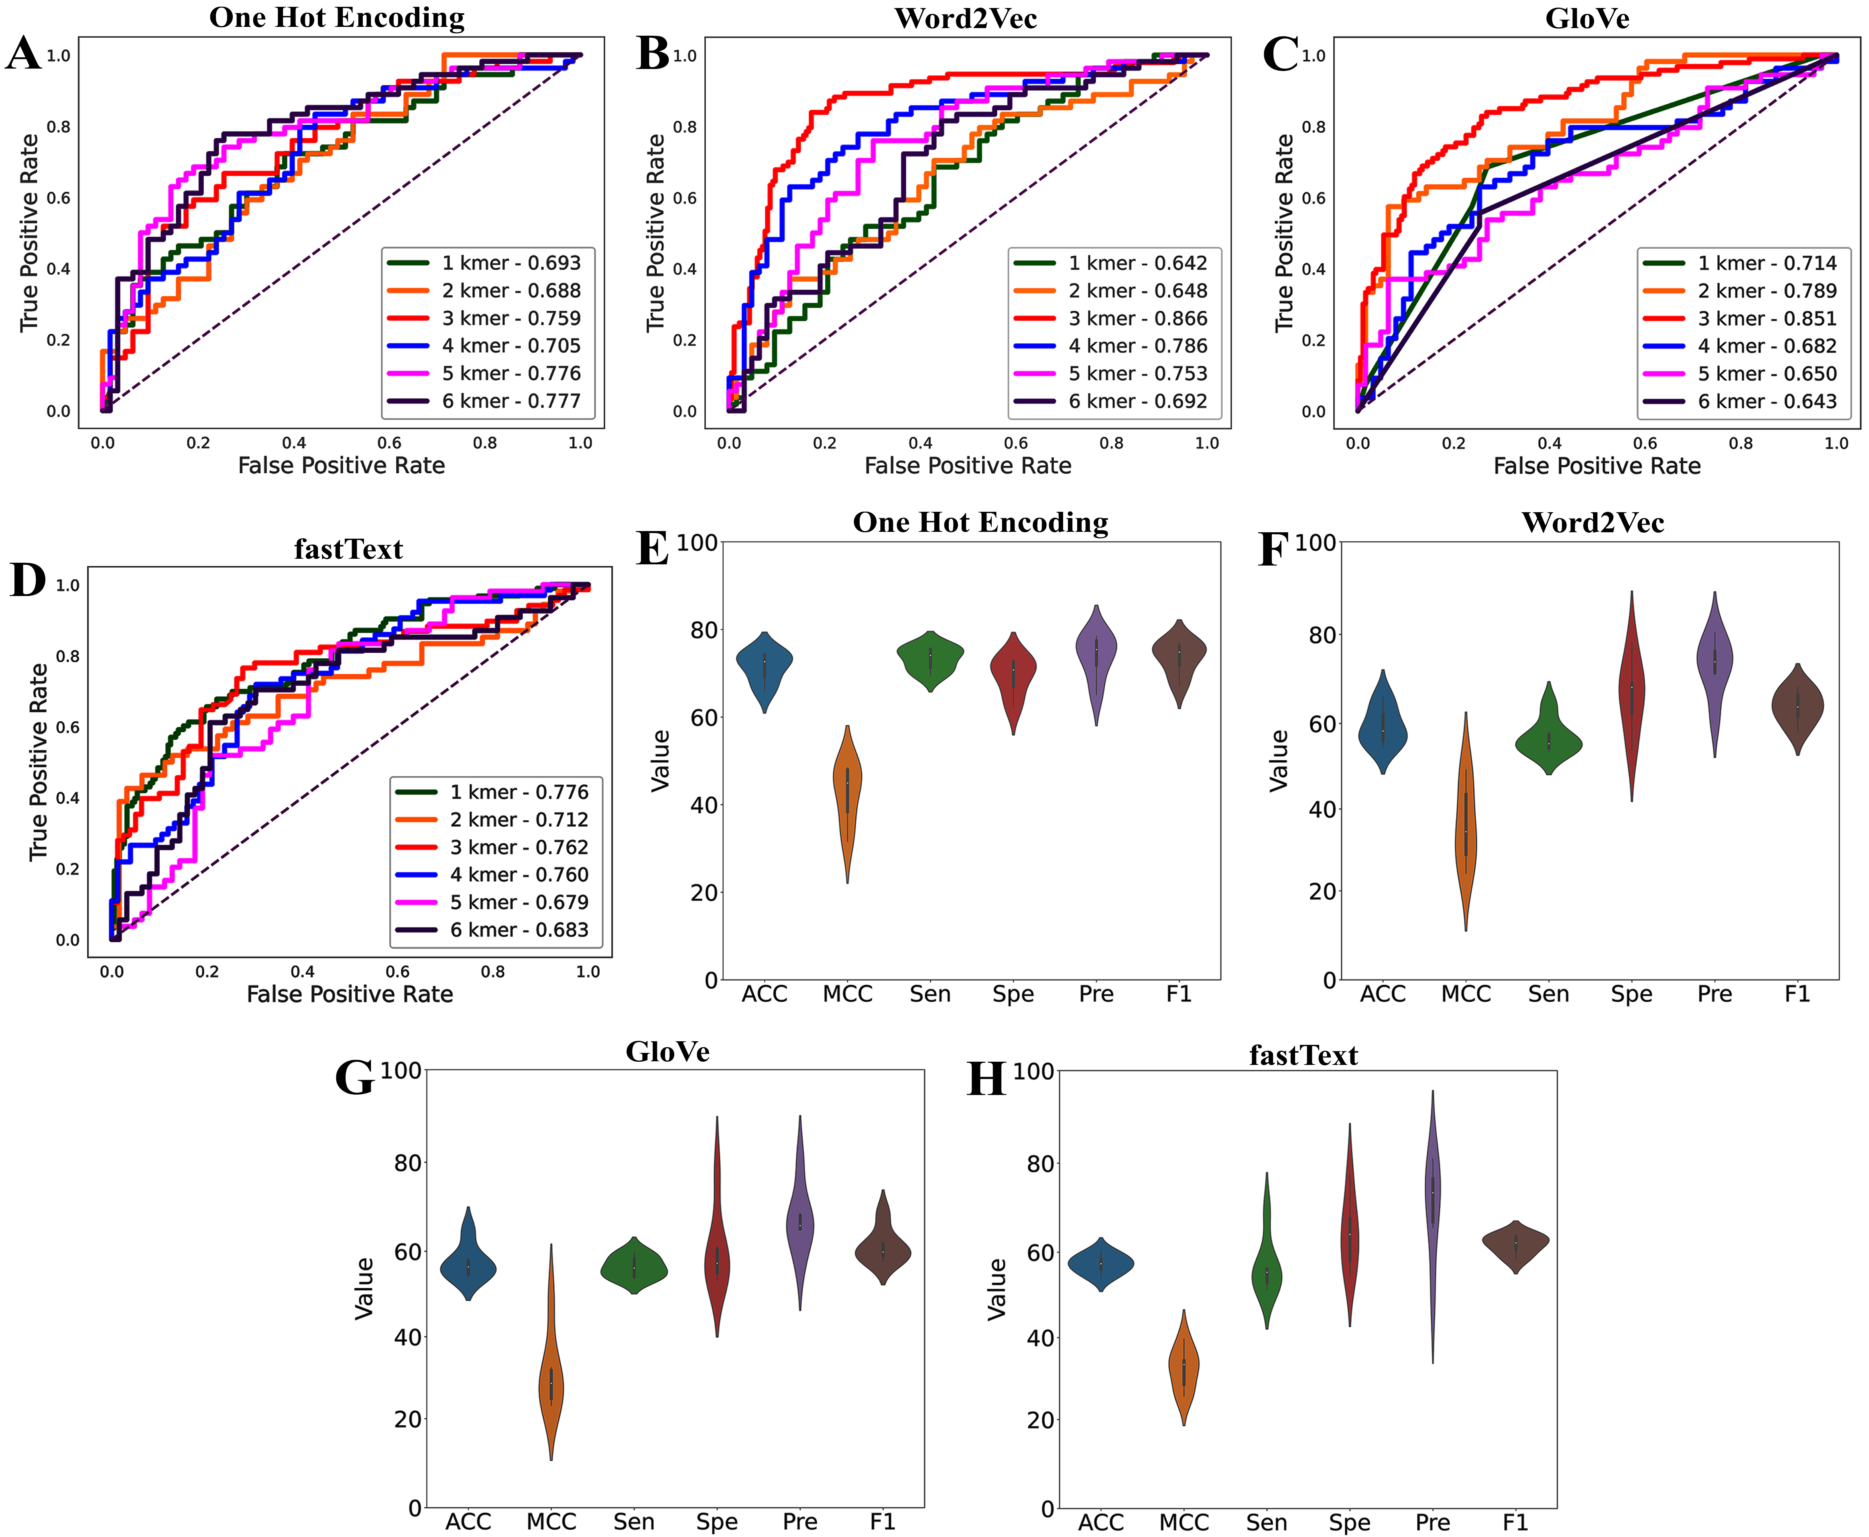
Result Analysis Cont…
Performance of each feature for different k-mer lengths
3/5/2025
Md. Faruk Hosen, IT-21618
18

Slide 19
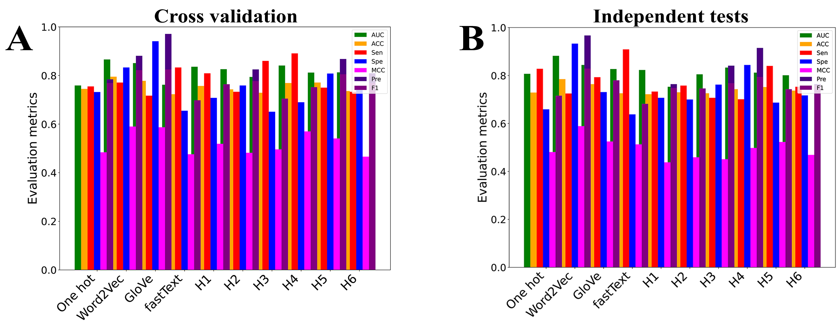
Result Analysis Cont...
AttLSTM model performance on single and hybrid feature
3/5/2025
Md. Faruk Hosen, IT-21618
19

Slide 20
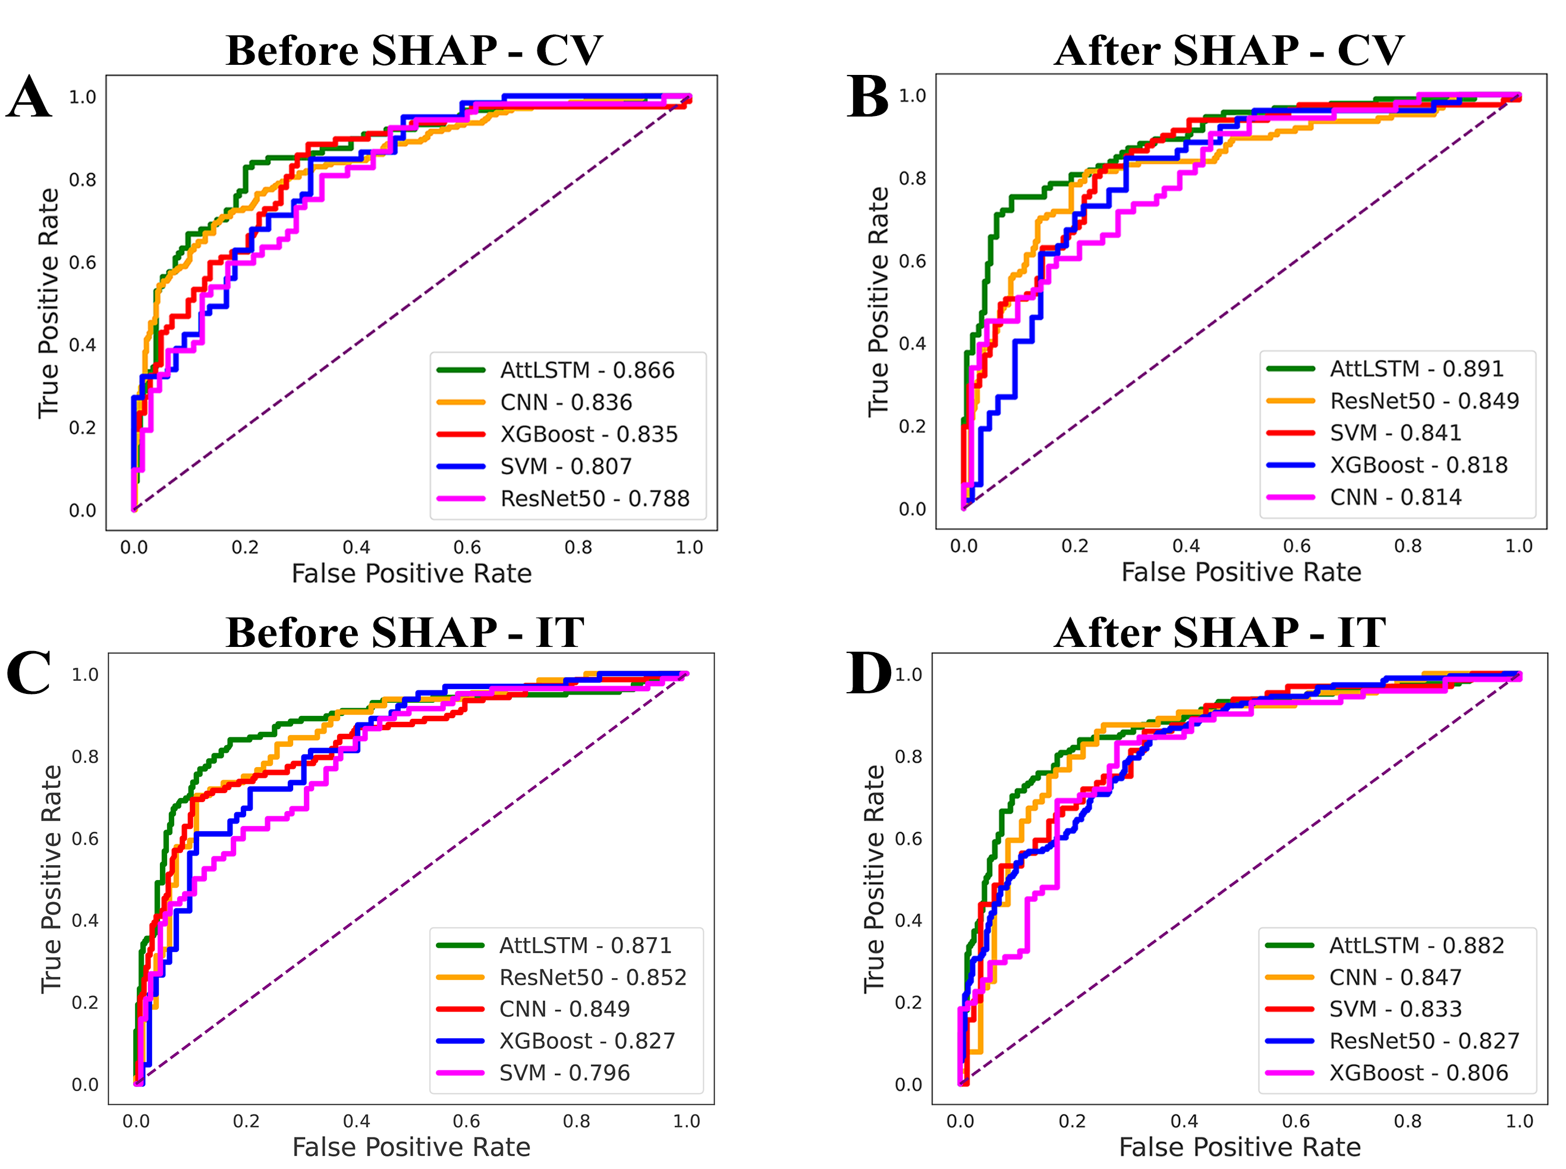
Result Analysis Cont...
ROC curves for SVM, XGBoost, CNN, ResNet50, and AttLSTM model
3/5/2025
Md. Faruk Hosen, IT-21618
20

Slide 21
Result Analysis Cont...
ROC curves for SVM, XGBoost, CNN, ResNet50, and AttLSTM model
3/5/2025
Md. Faruk Hosen, IT-21618
21

Slide 22
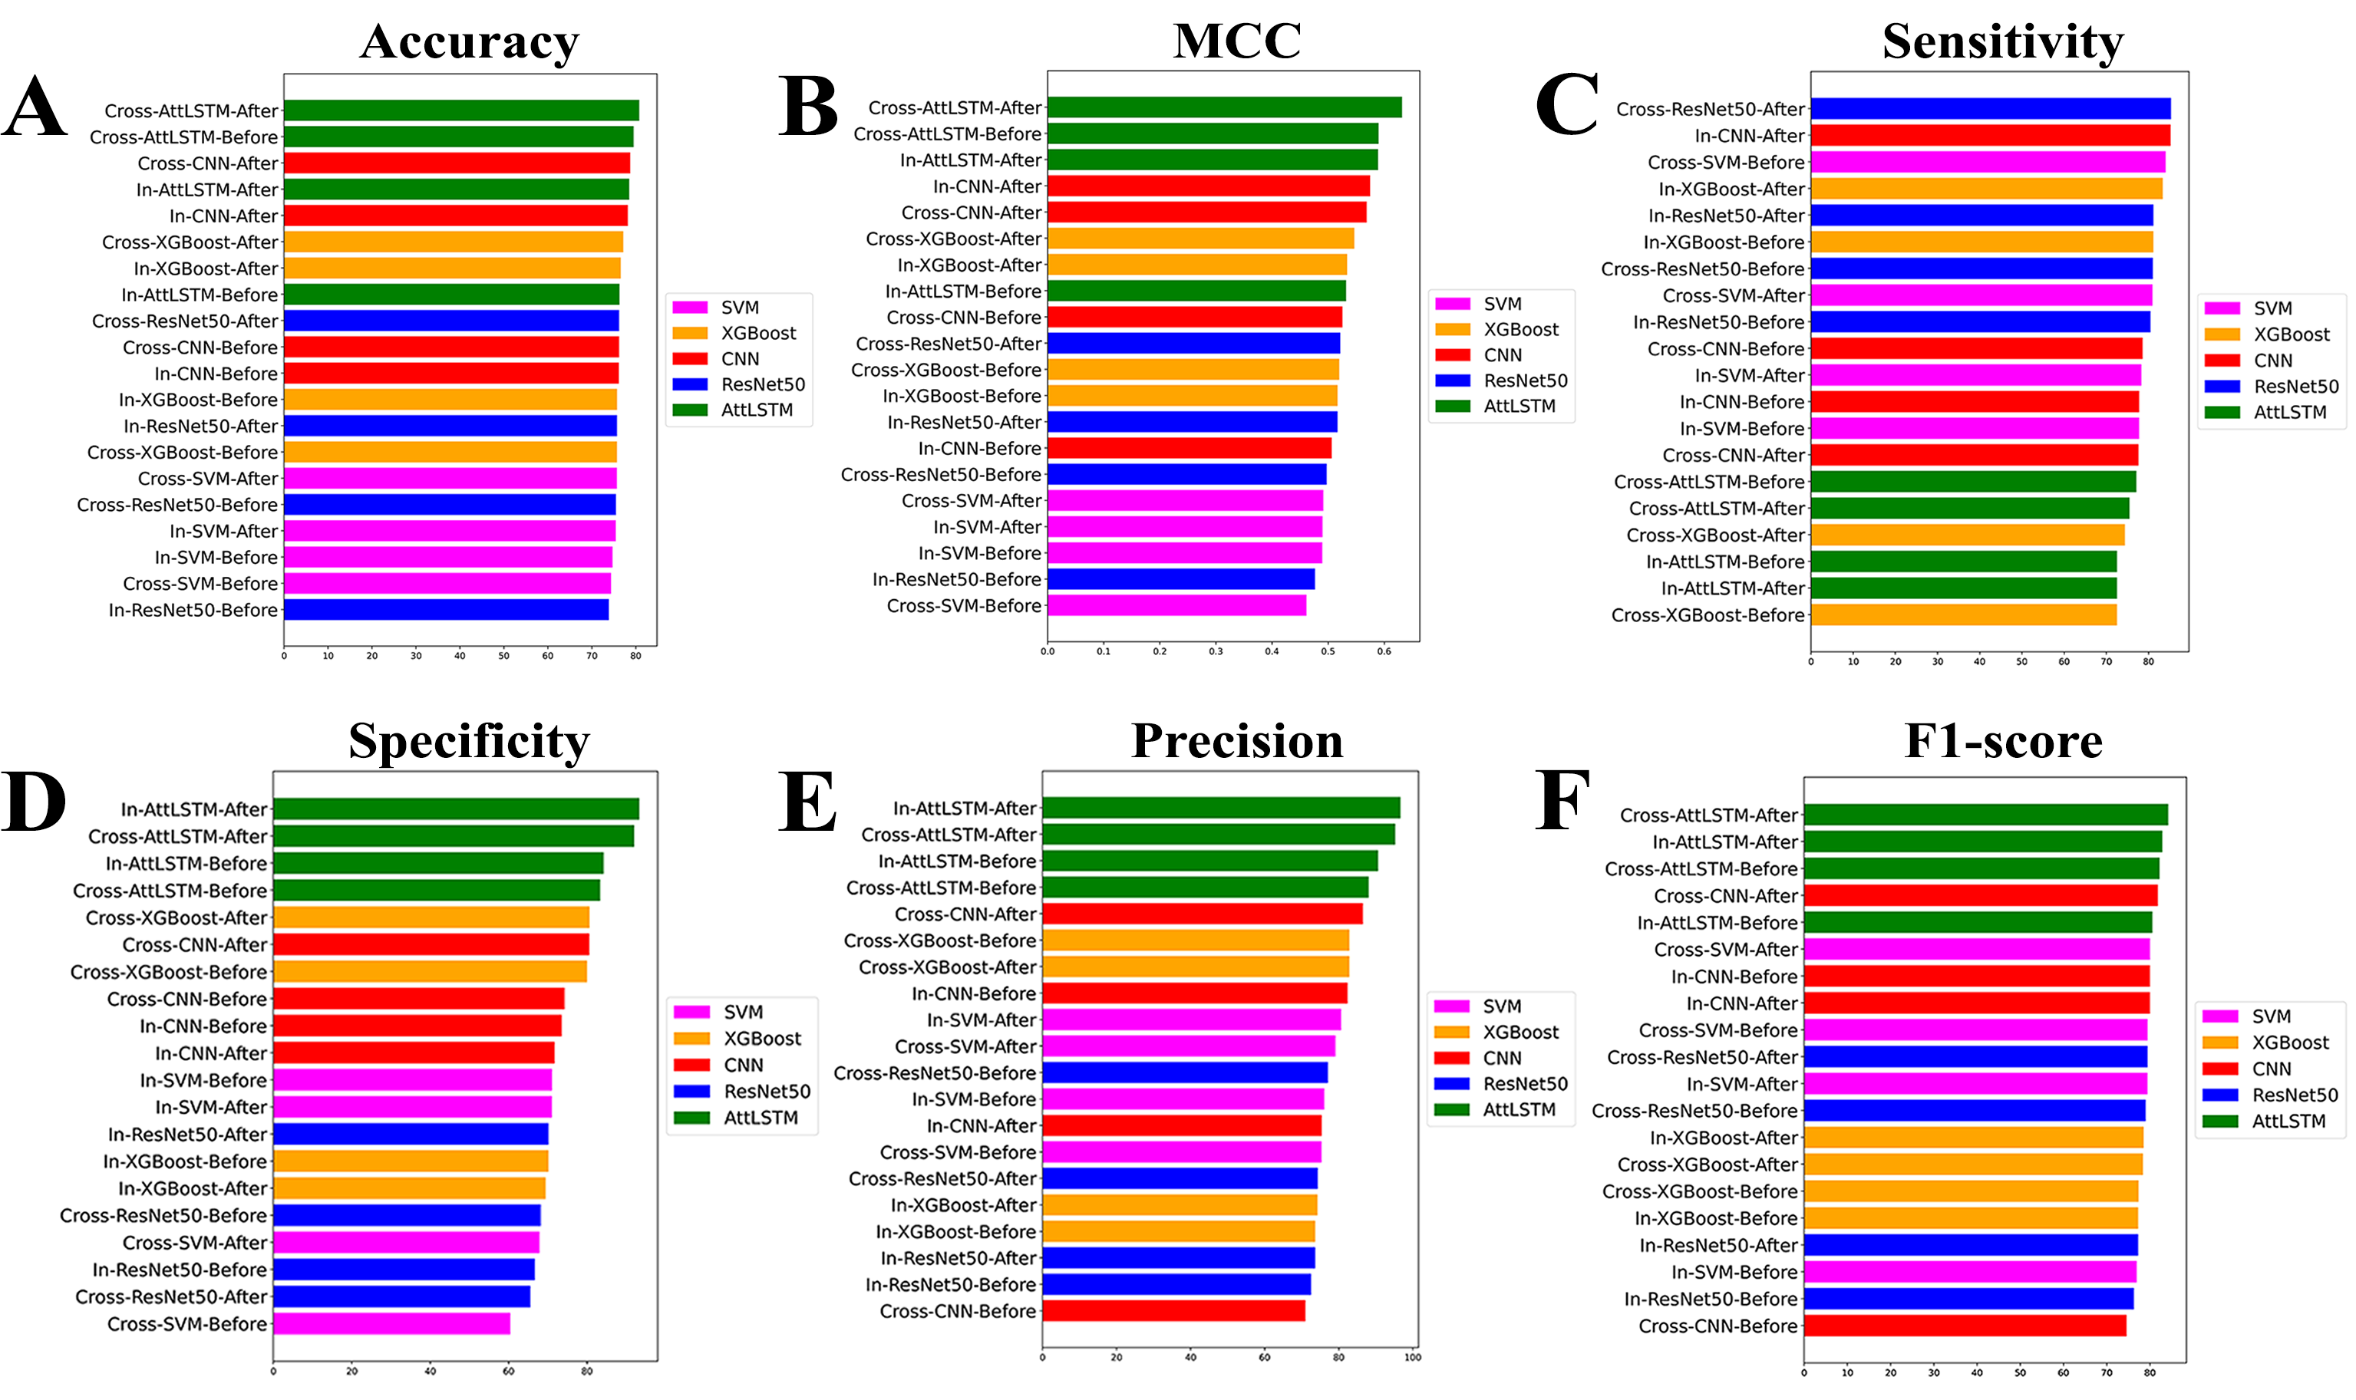
Result Analysis Cont...
Performance comparison of various ML classifiers before and after applying SHAP
3/5/2025
Md. Faruk Hosen, IT-21618
22

Slide 23
Result Analysis Cont...
Performance comparison of various ML classifiers before and after applying SHAP
3/5/2025
Md. Faruk Hosen, IT-21618
23

Slide 24
Result Analysis Cont.…
Hyperparameters for Different Models
Hyperparameters
SVM | C: 1.0, gamma: ‘scale’, kernel: ‘RBF’
XGBoost | Learning Rate : 0.2, Gamma : 0, Max_depth : 3, Min Child Weight : 1, Booster : gbtree
CNN | Learning rate : 0.00001, Batch Size : 32, Number of Filters : [32,64], Kernal Size : 4, Number of Hidden layers : 2, Optimizer : ‘Adam’, Dropout rate : 0.5, Activation : [‘relu’,′sigmoid′]
Resnet50 | Batch Size : 64, Kernal Size : 4, Number of Filters : 64, Optimizer : ‘Adam’, Activation : ′sigmoid′
AttLSTM | Activation function: ‘relu’, learning rate: [0.001, 0.0001, 0.002], batch size: [32,64], max epoch: [20,30,50], Optimizer: ‘Adam’
3/5/2025
Md. Faruk Hosen, IT-21618
24

Slide 25
Result Analysis Cont...
Ablation study on training dataset
Models | AUC | ACC | MCC | Sen | Spe | Pre | F1
without LSTM | 75.79% | 76.92% | 0.5455 | 73.08% | 84.62% | 90.48% | 80.85%
without first attention layer | 78.04% | 77.91% | 0.5595 | 81.39% | 74.42% | 76.09% | 78.65%
Without second attention layer | 75.91% | 76.20% | 0.5198 | 77.14% | 75.00% | 79.41% | 78.26%
Remove Both Attention Layers | 83.17% | 76.47% | 0.5254 | 77.19% | 75.56% | 80.00% | 78.57%
Remove the fully connected layer | 82.80% | 79.49% | 0.5872 | 78.26% | 81.25% | 85.71% | 81.81%
3/5/2025
Md. Faruk Hosen, IT-21618
25

Slide 26
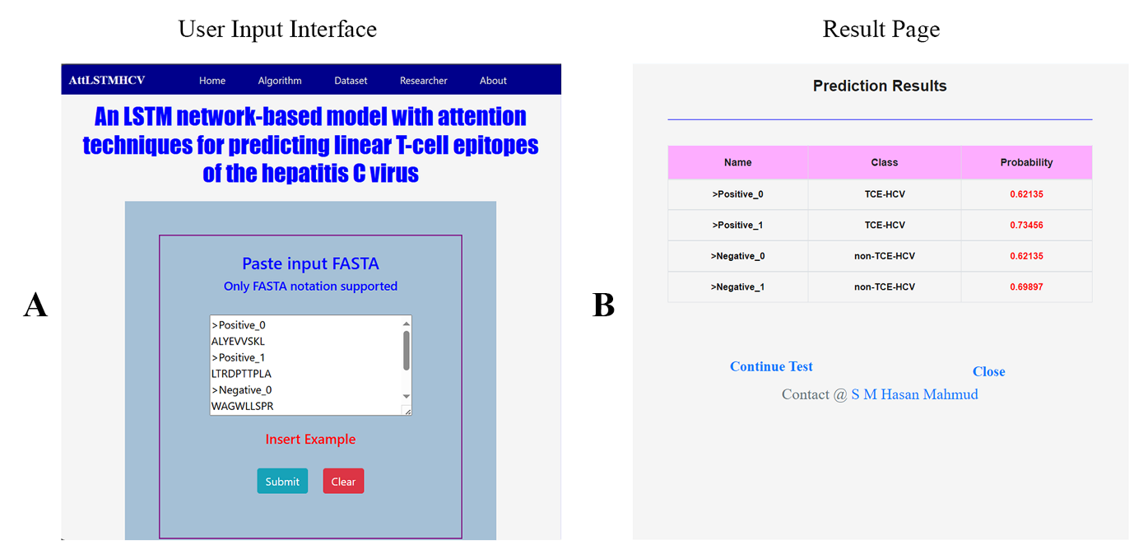
Result Analysis Cont...
Web Server Implementation
3/5/2025
Md. Faruk Hosen, IT-21618
26

Slide 27
Result Analysis Cont...
Comparison of our proposed AttLSTM with the existing method
Evaluation strategy | Method | ACC | Sen | Spe | MCC | AUC
Cross validation | TROLLOPE | 0.745 | 0.686 | 0.795 | 0.487 | 0.808
 | AttLSTM | 0.808 | 0.755 | 0.920 | 0.632 | 0.891
Independent test | TROLLOPE | 0.747 | 0.742 | 0.752 | 0.493 | 0.827
 | AttLSTM | 0.785 | 0.725 | 0.933 | 0.589 | 0.882
3/5/2025
Md. Faruk Hosen, IT-21618
27

Slide 28
Conclusion
Identification of T-cell epitopes of the hepatitis C virus (HCV) is essential for drug design and has a wide range of applications in medical research and pharmaceutical industry.
Experimental results have shown that our proposed model achieves more accurate and improved predictions of TCE-HCVs.
In summary, we recommend that our method offers a promising solution for improving TCE-HCVs prediction from primary sequence information.
It provides valuable insights for biologists and scientists engaged in vaccine development research.
3/5/2025
Md. Faruk Hosen, IT-21618
28

Slide 29
Future Work
In the future, We aim to implement and evaluate various deep learning architectures to identify potential improvements in TCE-HCV prediction.
To complement our computational approach, we intend to conduct experimental validations to verify the model's predictions and refine its accuracy.
Furthermore, we will also try to implement and test our model on datasets related to other diseases, assessing its generalizability in broader immunological research.
3/5/2025
Md. Faruk Hosen, IT-21618
29

Slide 30
Achievement
Md. Faruk Hosen, S.M.H. Mahmud, Ahmed, K., Chen, W., Moni, M.A., Deng, H.W., Shoombuatong, W. and Hasan, M.M., 2022. DeepDNAbP: A deep learning-based hybrid approach to improve the identification of deoxyribonucleic acid-binding proteins. Computers in Biology and Medicine, Elsevier, 145, p.105433. [Q1 Ranked Journal, IF = 7.0]
Md. Faruk Hosen, S.M.H. Mahmud, Goh, K. O. M., Uddin, M. S., Nandi, D., Shatabda, S., Shoombuatong, An LSTM network-based model with attention techniques for predicting linear T-cell epitopes of the hepatitis C virus, Results in Engineering. (2024) 103476. [Q1 ranked journal, IF:6.0]
M.A. Basar, Md. Faruk Hosen, Paul, B.K., Hasan, M.R., Shamim, S.M. and Bhuyian, T., 2023. Identification of drug and protein-protein interaction network among stress and depression: A bioinformatics approach. Informatics in medicine unlocked, Elsevier, 37, p.101174. [Q2 Ranked Journal, IF = 3.4]
S.M.H. Mahmud, Goh, K.O.M., Md. Faruk Hosen, Nandi, D. and Shoombuatong, W., 2024. Deep-WET: a deep learning-based approach for predicting DNA-binding proteins using word embedding techniques with weighted features. Scientific Reports, Nature Portfolio, 14(1), p.2961. [Q1 Ranked Journal, IF = 3.8]
M. K. Alam, Md. Faruk Hosen, K. K. Ganji, K. Ahmed, & F. M. Bui (2024). Identification of key signaling pathways and novel computational drug target for oral cancer, metabolic disorders and periodontal disease. Journal of Genetic Engineering and Biotechnology, 22(4), 100431.[Q2 ranked journal, IF: 3.6]
3/5/2025
Md. Faruk Hosen, IT-21618
30

Slide 31
References
[1] Manns, M.P., Buti, M., Gane, E.D., Pawlotsky, J.M., Razavi, H., Terrault, N. and Younossi, Z., 2017. Hepatitis C virus infection. Nature reviews Disease primers, 3(1), pp.1-19.
[2] World Health Organization, 2021. Global progress report on HIV, viral hepatitis and sexually transmitted infections, 2021: accountability for the global health sector strategies 2016–2021: actions for impact. World Health Organization.
[3] Charoenkwan, P., Waramit, S., Chumnanpuen, P., Schaduangrat, N. and Shoombuatong, W., 2023. TROLLOPE: A novel sequence-based stacked approach for the accelerated discovery of linear T-cell epitopes of hepatitis C virus. Plos one, 18(8), p.e0290538.
[4] Dhanda, S.K., Gupta, S., Vir, P. and Raghava, G.P.S., 2013. Prediction of IL4 inducing peptides. Journal of Immunology Research, 2013.
[5] Bukhari, S.N.H., Jain, A., Haq, E., Mehbodniya, A. and Webber, J., 2022. Machine learning techniques for the prediction of B-cell and T-cell epitopes as potential vaccine targets with a specific focus on SARS-CoV2 pathogen: A review. Pathogens, 11(2), p.146.
[6] Thimme, R., 2021. T cell immunity to hepatitis C virus: Lessons for a prophylactic vaccine. Journal of hepatology, 74(1), pp.220-229.
3/5/2025
Md. Faruk Hosen, IT-21618
31

Slide 32
Thank You
3/5/2025
Md. Faruk Hosen, IT-21618
32

